Slide 1

Presented By:Vivek Borgalle
ORANGE HRM
(Capstone Project )
Presented to Saritha Mam
FROM BATCH:9(SELENIUM)

Slide 2

GIT URL
https://github.com/Vivek051/Project-OrangeHRM.git
The OrangeHRM Automation Project focuses on testing the HR management system to ensure seamless functionality across its core modules such as recruitment, leave management, payroll, and employee records. The main objective is to automate end-to-end HR processes, enhance test coverage, and reduce manual effort by implementing Selenium with TestNG. Continuous Integration and Continuous Deployment (CI/CD) is achieved using Jenkins, while defect tracking and collaboration are managed through JIRA and GitHub. This approach ensures improved reliability, faster test execution, and efficient maintenance of HR operations.

Slide 3
Problem Statement
OrangeHRM is a web-based Human Resource Management system that helps organizations manage employee details, leave, recruitment, and time tracking. It provides an easy-to-use platform designed for both HR managers and employees. The system is highly scalable and customizable, making it suitable for small, medium, and large organizations. With key modules like Admin, PIM, Leave, Recruitment, and Time & Attendance, OrangeHRM streamlines HR operations while improving efficiency, accuracy, and overall productivity.
.
Project Objective
The objective of this project is to automate functional and regression test cases of OrangeHRM to ensure accuracy, consistency, and faster execution. Automation reduces manual effort and minimizes human errors while providing reusable and scalable test scripts. It also supports continuous integration and enables faster delivery cycles, improving overall testing efficiency and product quality.

Slide 4
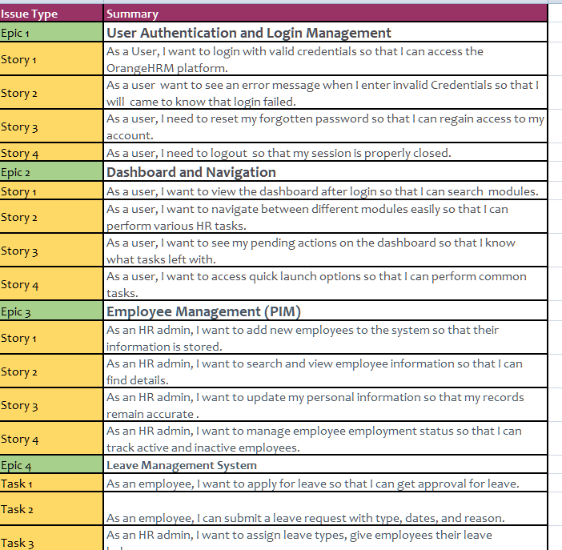
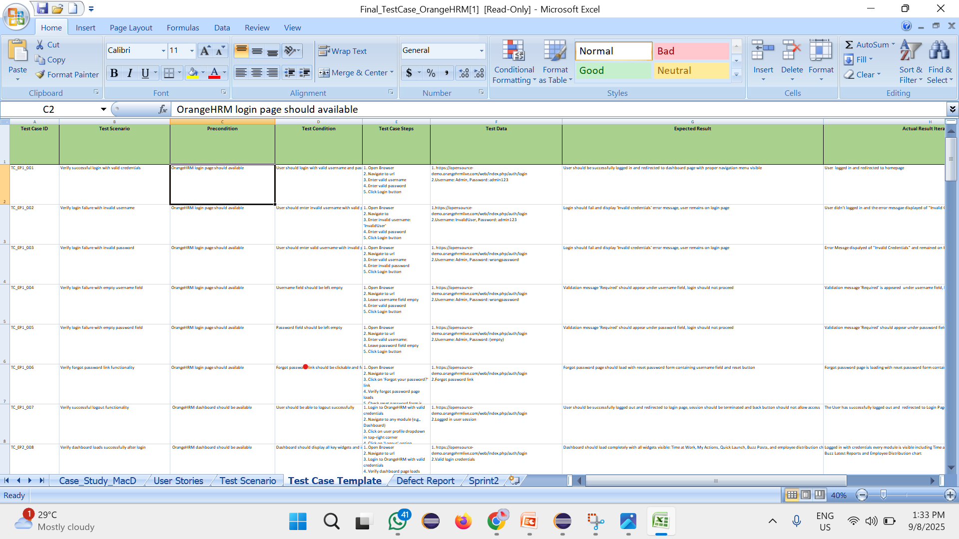
Manual Test Cases

Slide 5
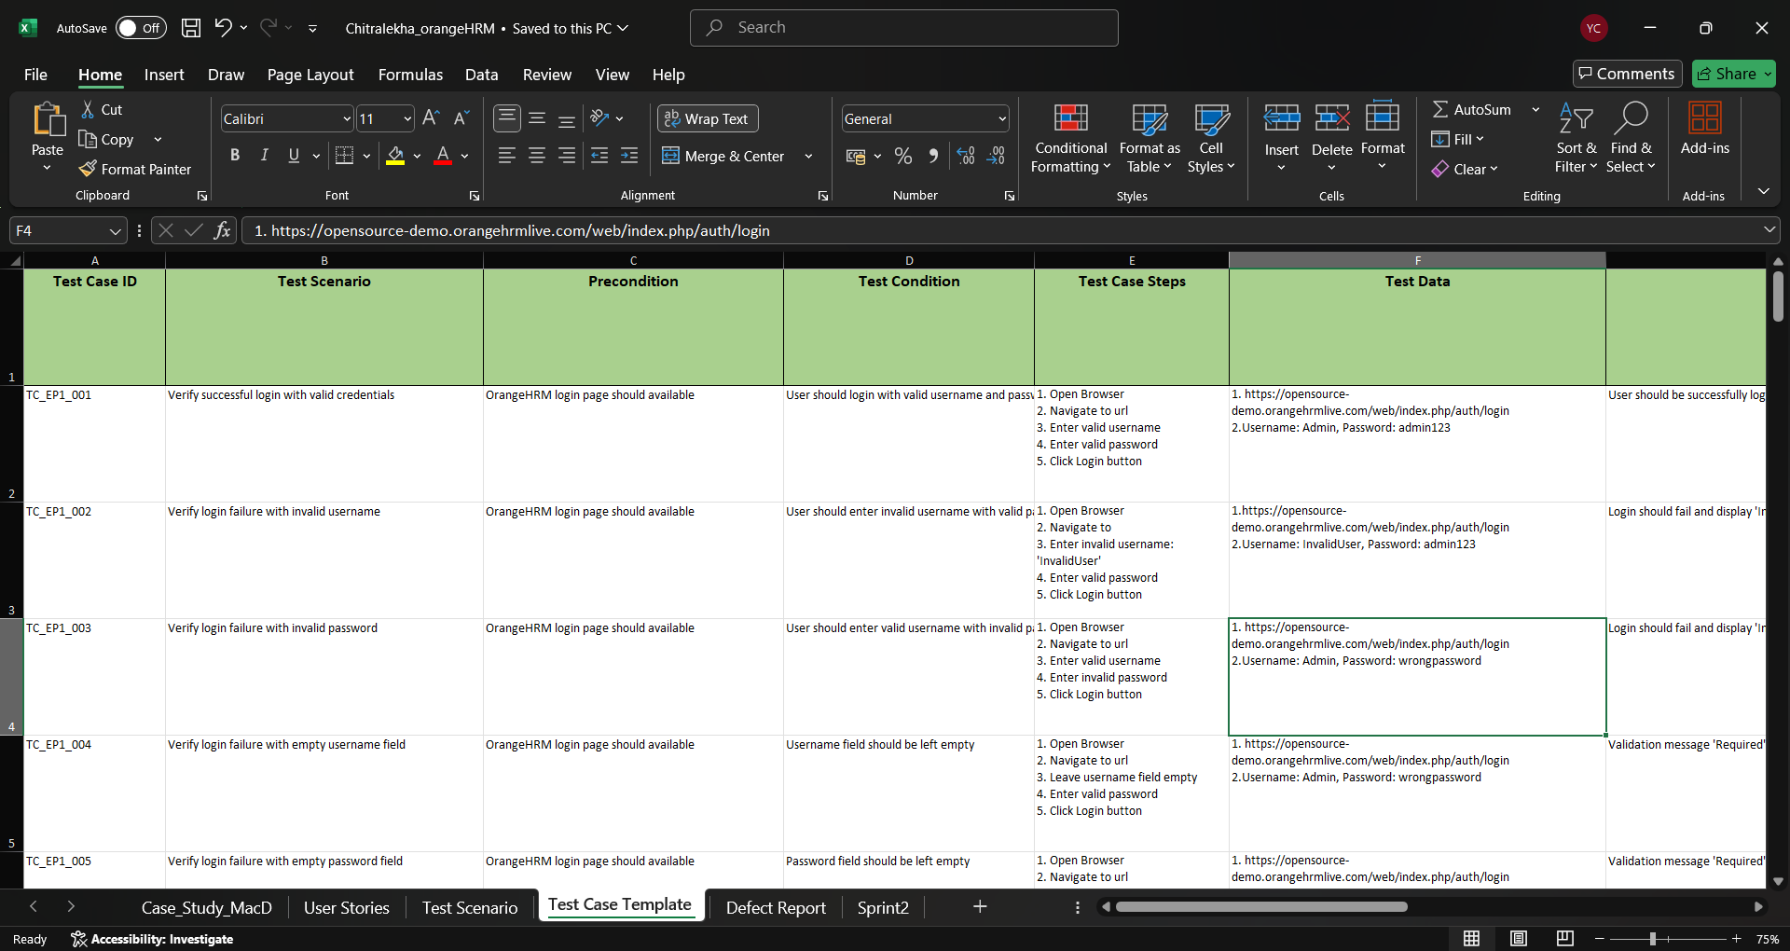
Manual Test Cases

Slide 6
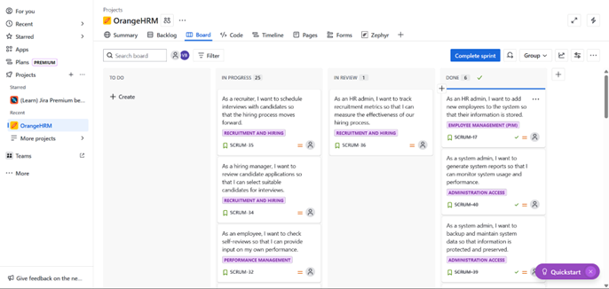
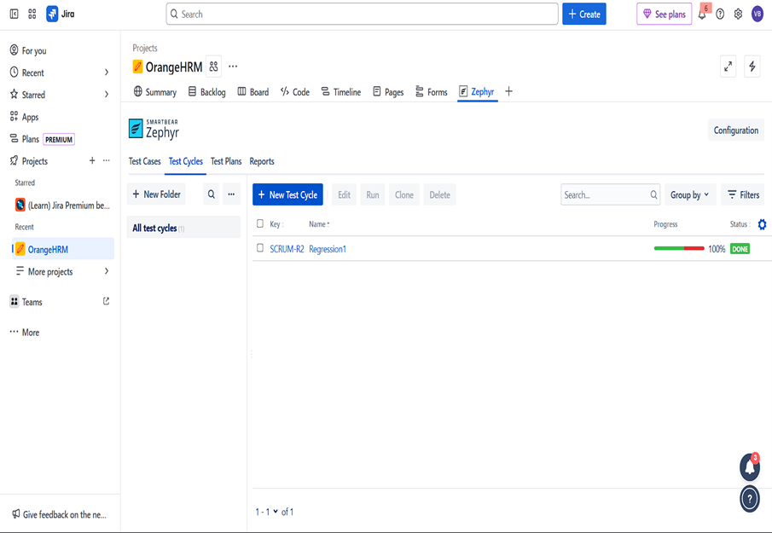
JIRA

Slide 7
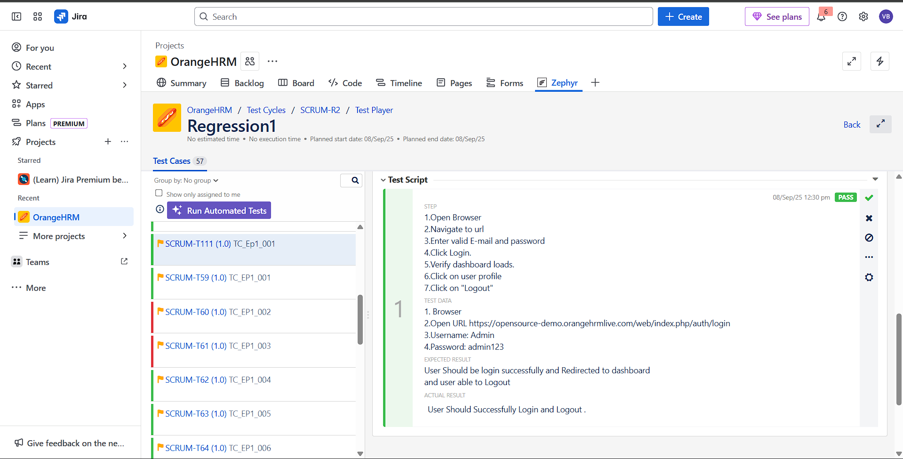
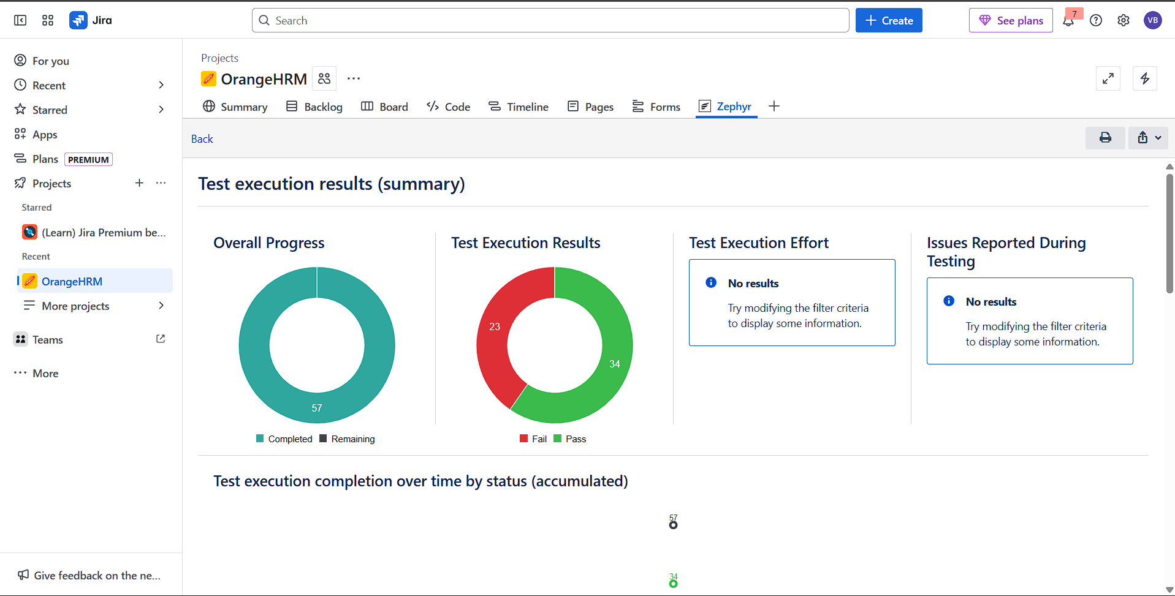
JIRA

Slide 8






Project Structure
src/main/java
Core implementation and utilities
src/test/java
Test scripts and scenarios
src/main/resources
Configurations and supporting files
src/test/resources
Test data, reports, screenshots
Maven
Build management and dependency handling
JUnit/TestNG
Test execution

Slide 9
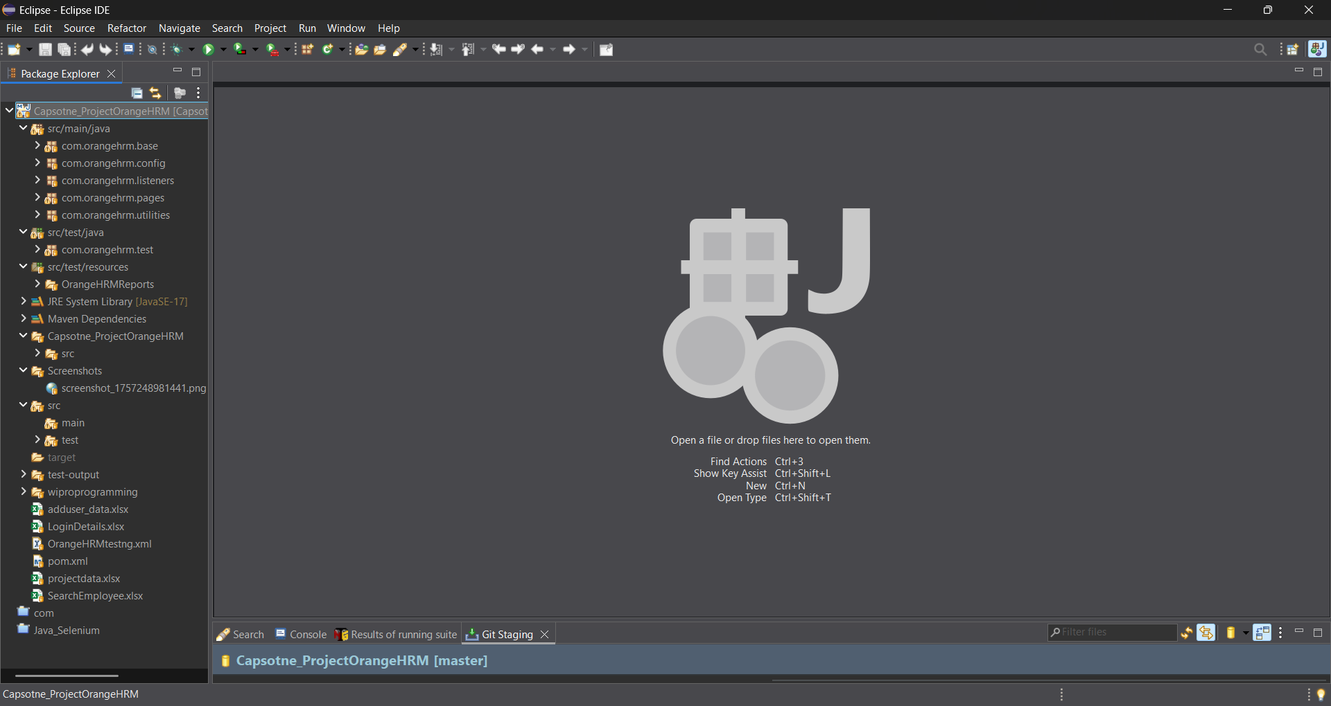
Project Structure
src/main/java
Core implementation and utilities
src/test/java
Test scripts and scenarios
src/main/resources
Configurations and supporting files
src/test/resources
Test data, reports, screenshots
Maven
Build management and dependency handling
JUnit/TestNG
Test execution

Slide 10
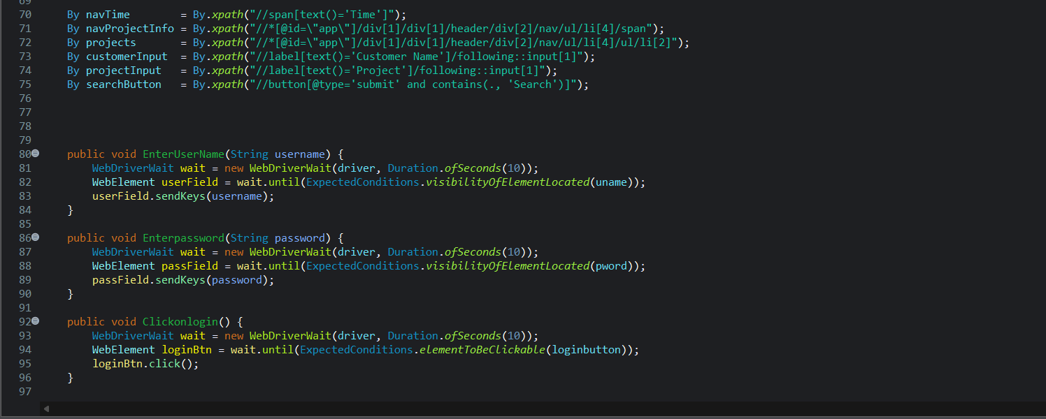
Locators

Slide 11
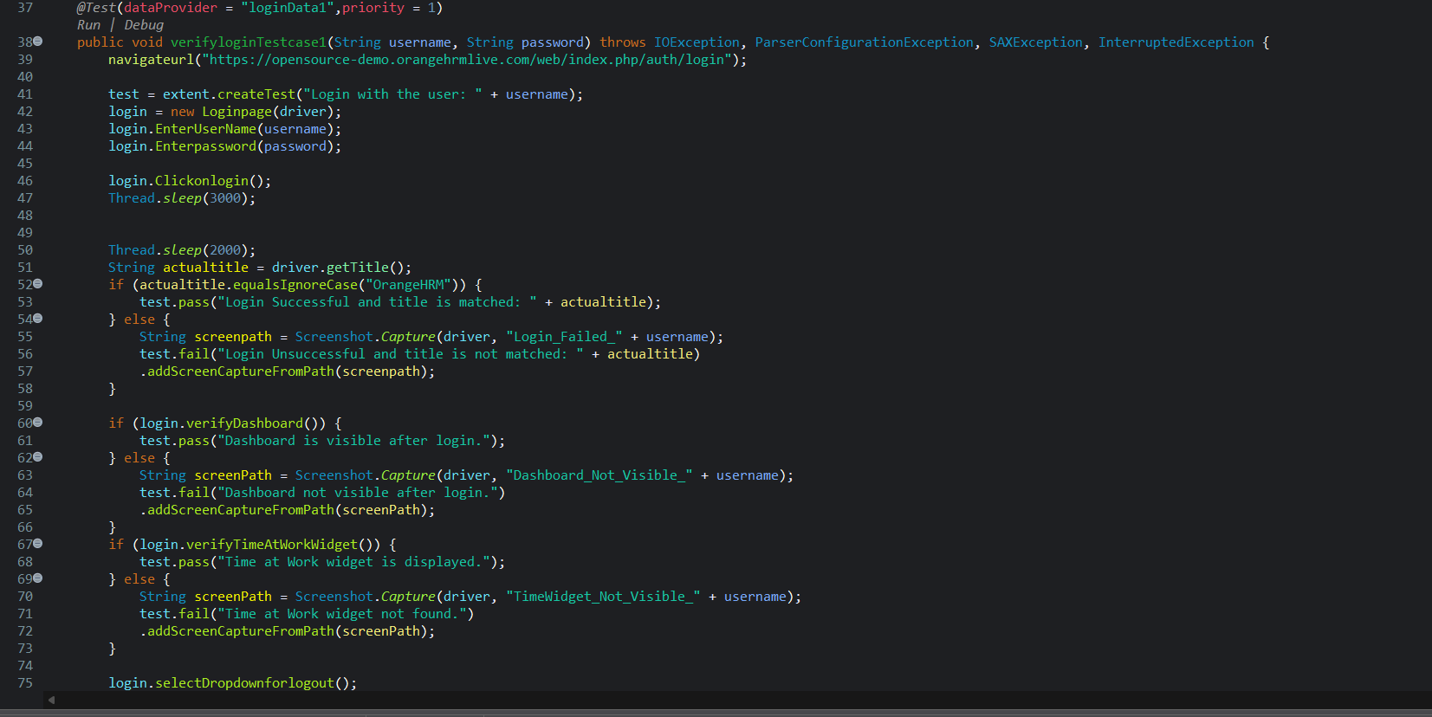
TestCase Method:

Slide 12
TEST CASE 1 LOGIN
STEPS | RESULTS
Precondition | Browser open with OrangeHRM, user on Home page.
Enter valid username & password, then click Login. | User should login successfully and be redirected to Dashboard.
Verify Dashboard loads correctly. | Dashboard should be visible with all elements.
Click on user profile and select Logout. | User should be logged out successfully.

Slide 13
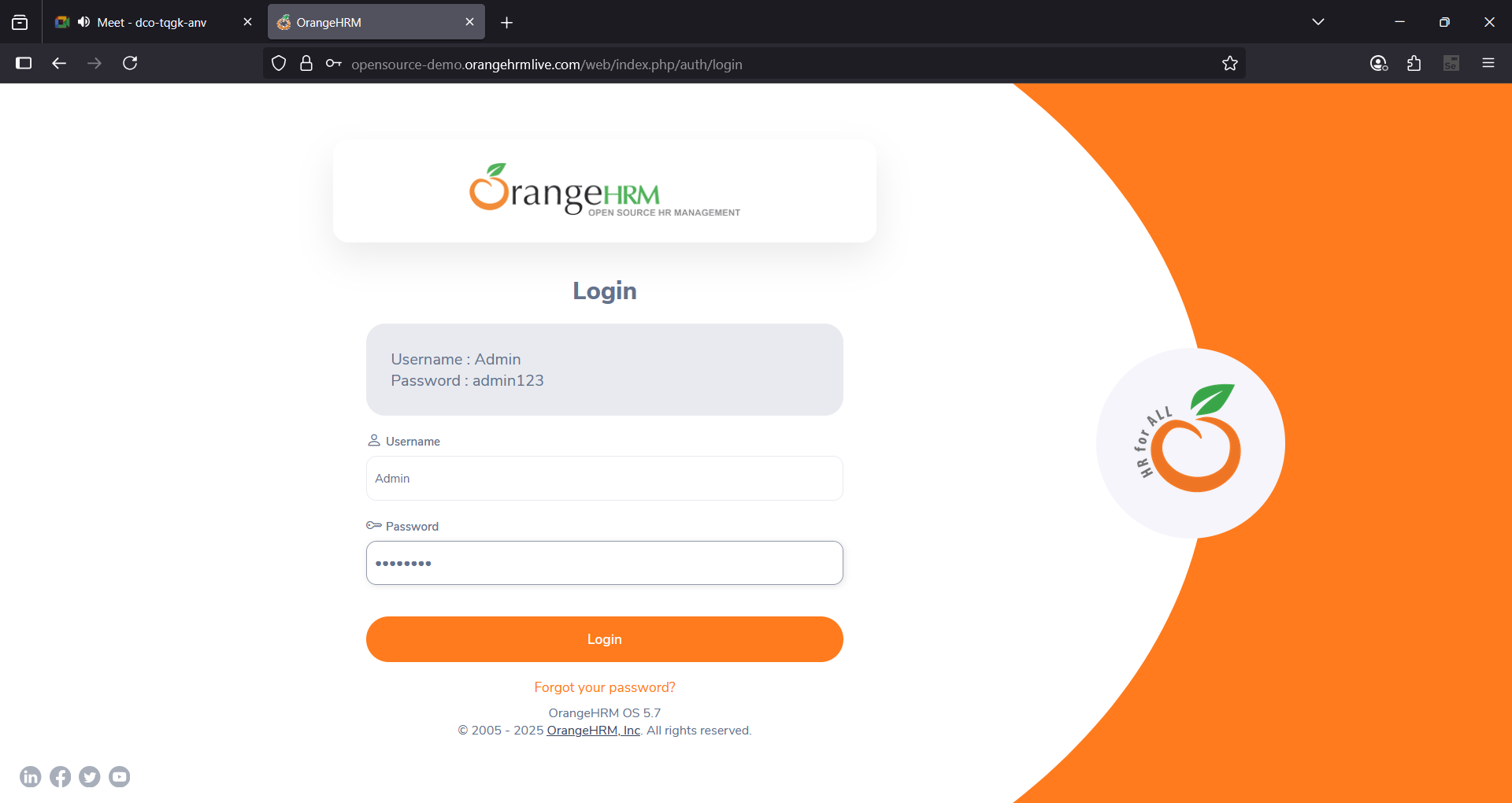
Test Flow TC001

Slide 14
TEST CASE 2 Add and Search Employee
STEPS | RESULTS
Precondition | Browser open with OrangeHRM, user on Home Page, PIM module enabled.
Admin logs in successfully. | User should be redirected to Dashboard.
Navigate to PIM and add a new Employee with valid details. | Employee should be created successfully.
Navigate to Employee List and search by Employee Name/ID. | Added Employee should appear in the search results.
Admin logs out. | User should be logged out successfully.

Slide 15
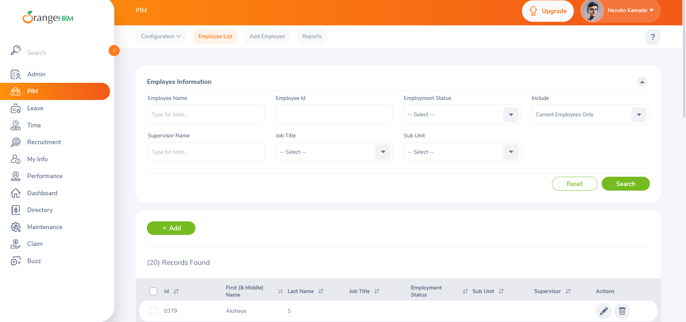
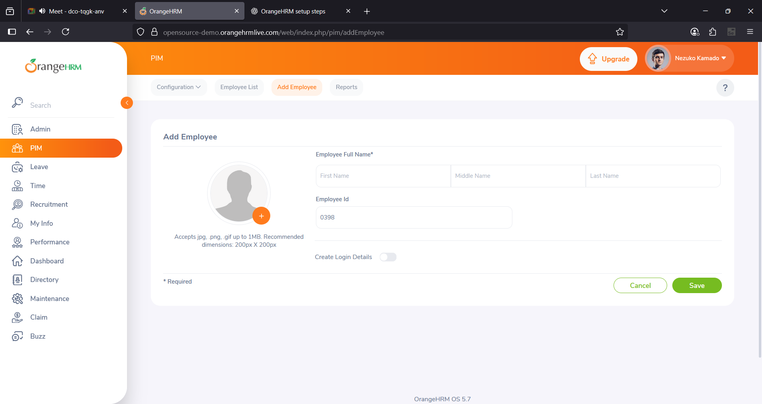
TEST FLOW TC002

Slide 16
TEST CASE 3 -Verify Employee Search in PIM Widget
STEPS | RESULTS
Precondition | Browser open with OrangeHRM, user logged in, Employee & HR Admin accounts exist.
User logs in successfully. | User should be redirected to Dashboard.
Navigate to PIM module. | PIM page should be displayed.
Search Employee by Name, ID, or Supervisor. | Employee details should be retrieved.
Verify searched Employee information. | Employee data should be displayed correctly.

Slide 17
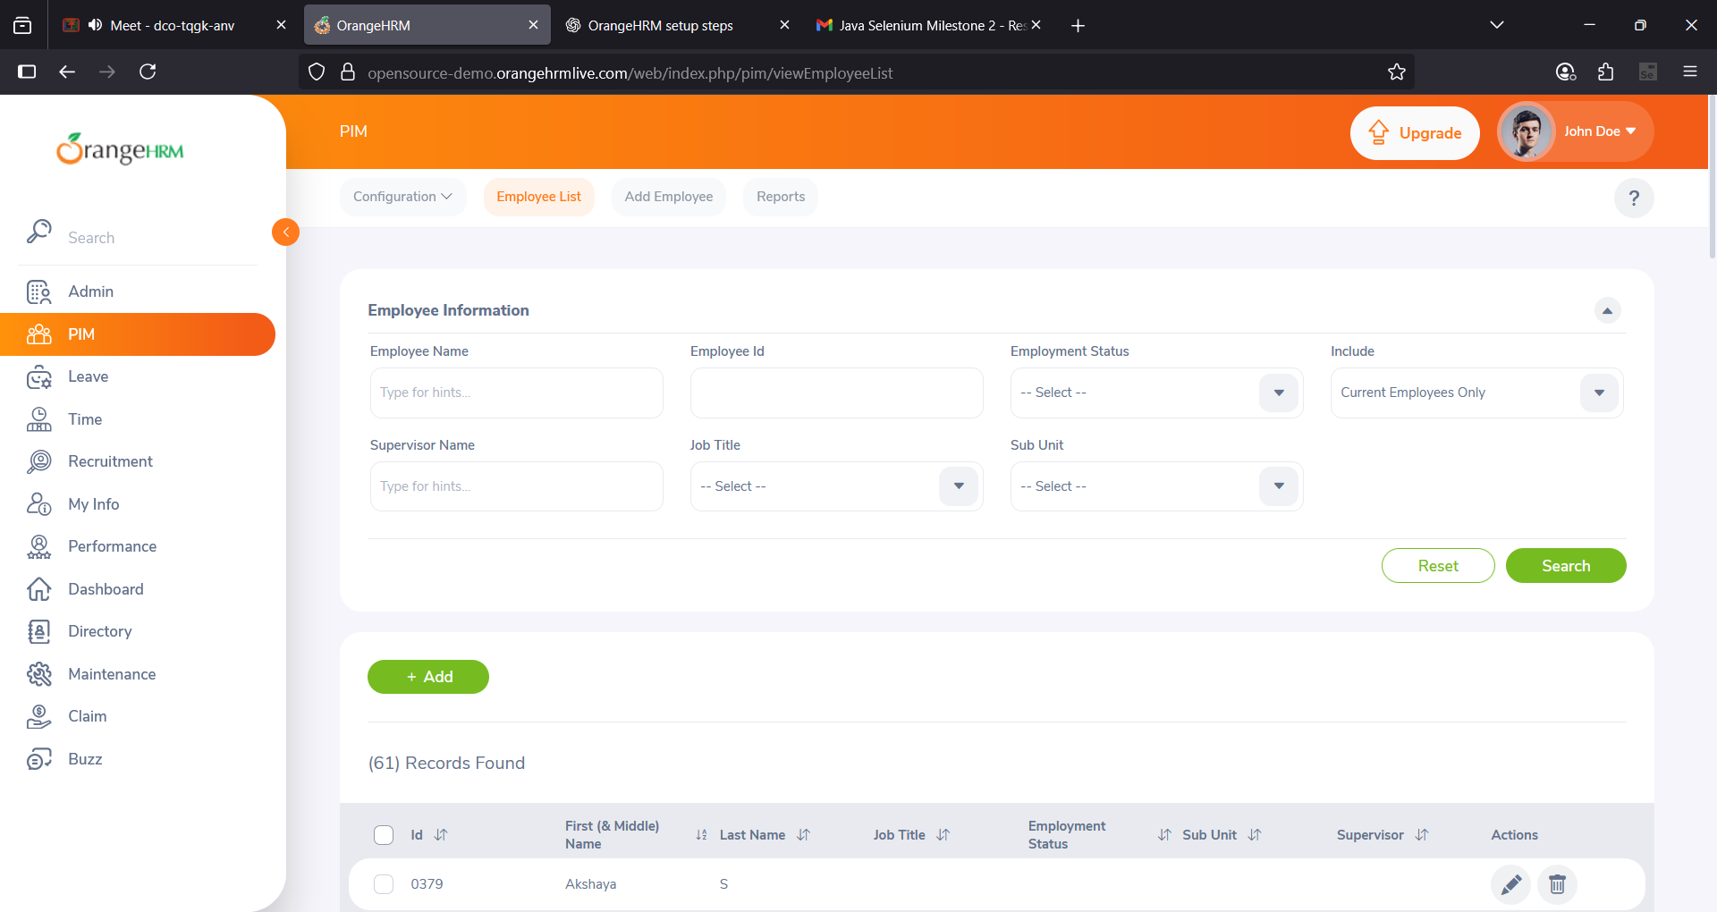
TEST FLOW TC003

Slide 18
TEST CASE 4 -Verify My Leave Records
STEPS | RESULTS
Precondition | Browser open with OrangeHRM, user account exists, Leave widget present.
Admin logs in successfully. | User should be redirected to Dashboard.
Navigate to My Leave section. | My Leave page should be displayed.
Select From Date and To Date, then click Search. | Leave records should be displayed.
Admin logs out. | Session should be closed successfully.

Slide 19
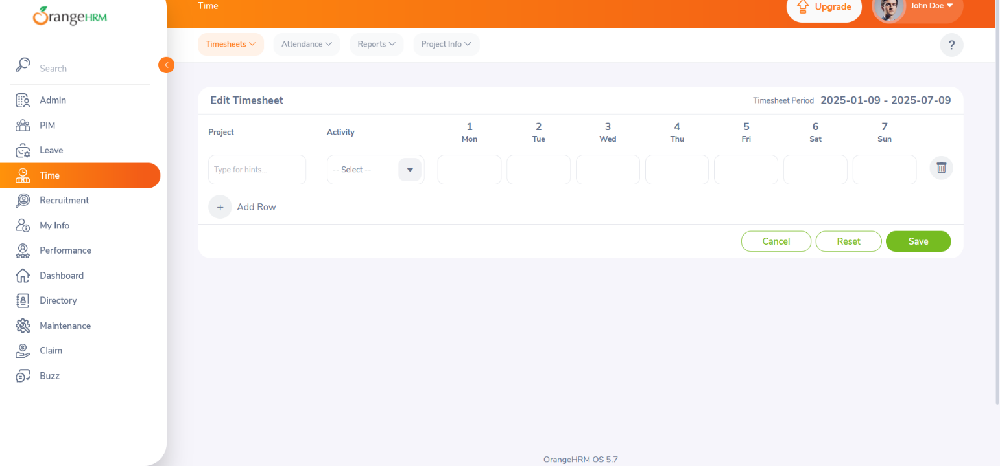
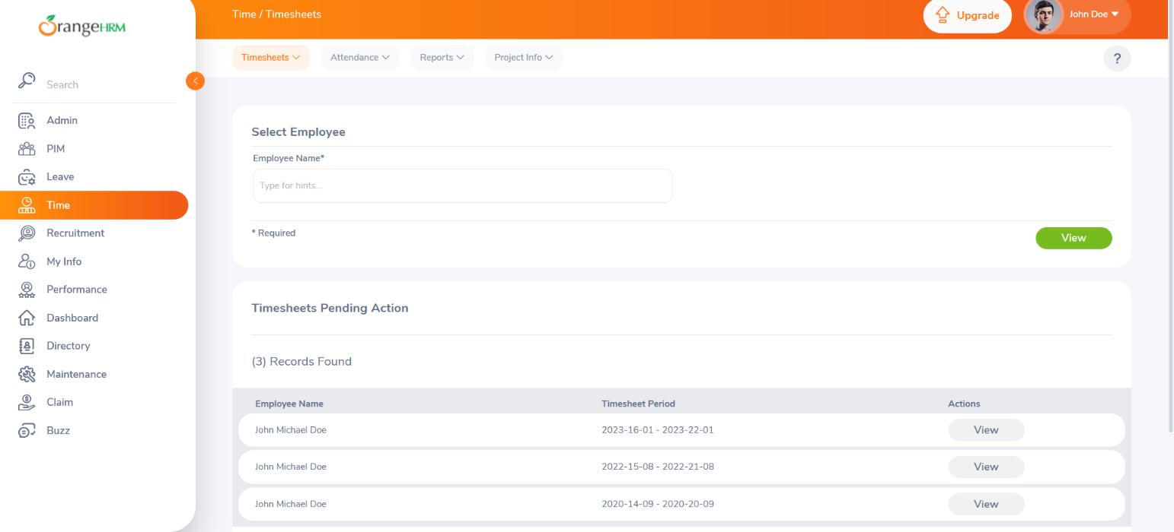
TEST FLOW TC004

Slide 20
TEST CASE 5-Verify Customer Projects
STEPS | RESULTS
Precondition | Browser open with OrangeHRM, user account exists, projects assigned.
Employee logs in successfully. | User should be redirected to Dashboard.
Navigate to My Time widget → Projects Info. | Projects Info page should be displayed.
Select Project and enter Customer Name & Project Name. | Project search should be performed.
Verify project details. | Project should be displayed with related data.
Employee logs out. | Session should be closed successfully.

Slide 21
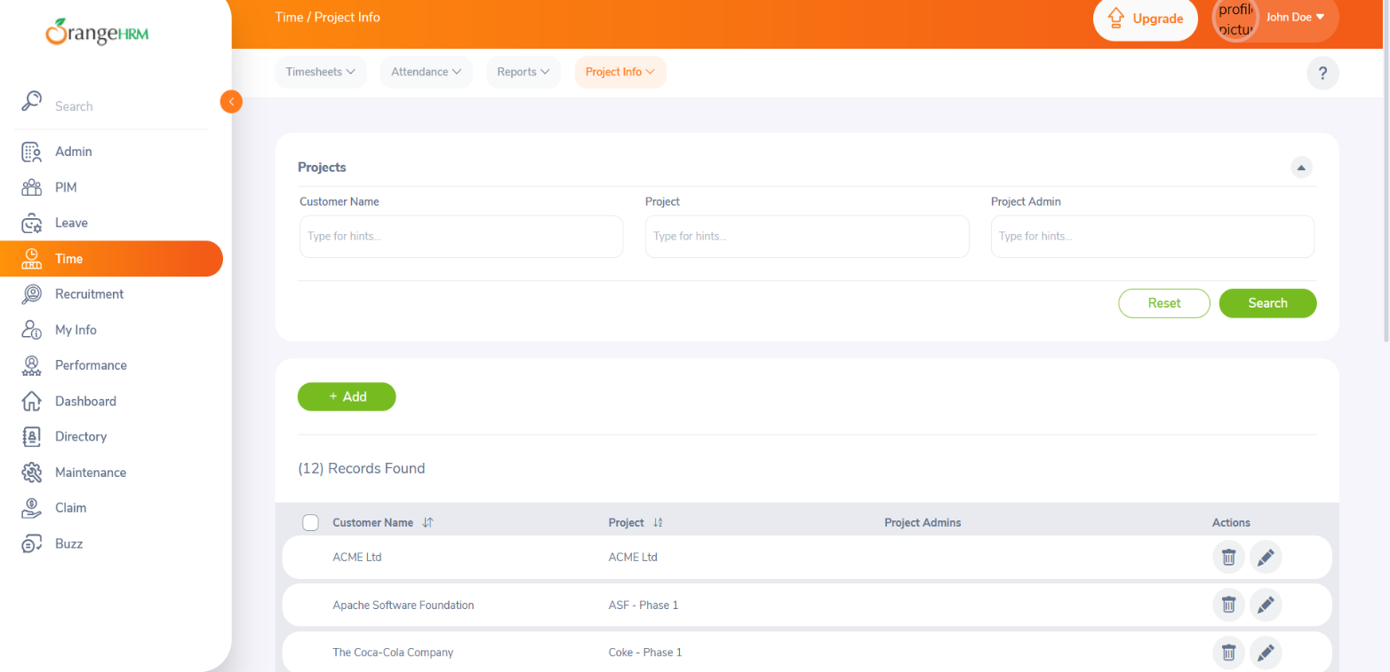
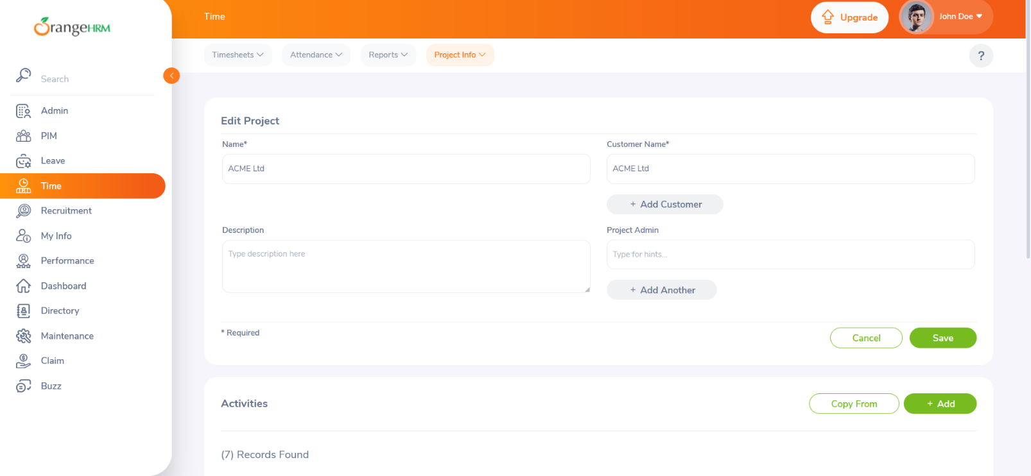
TEST FLOW TC005

Slide 22
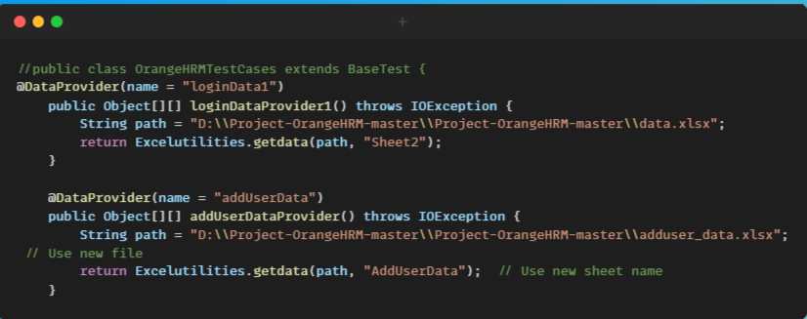
Scripts

Slide 23
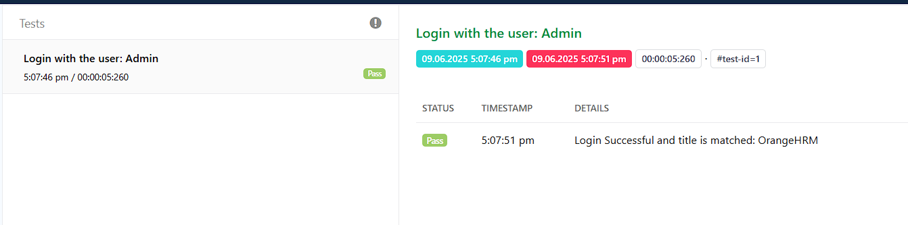
Test Report 1
Notes:
Test Case

Slide 24
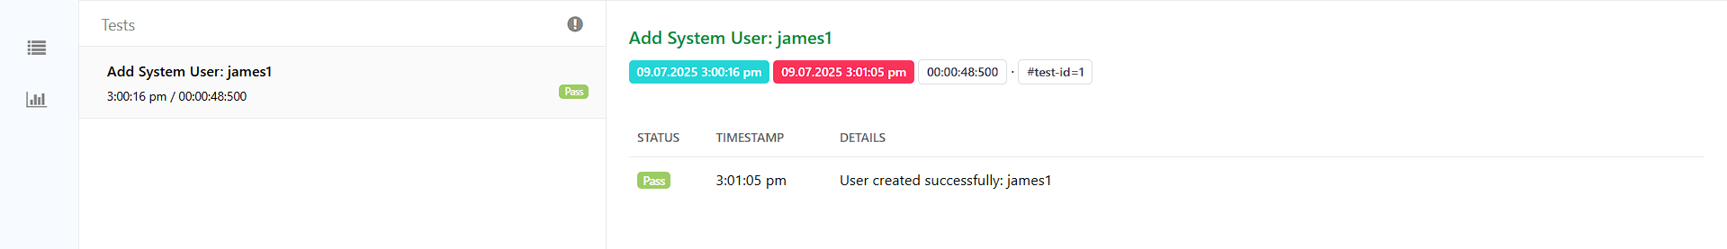
Test Report 2
Notes:
Test Case

Slide 25
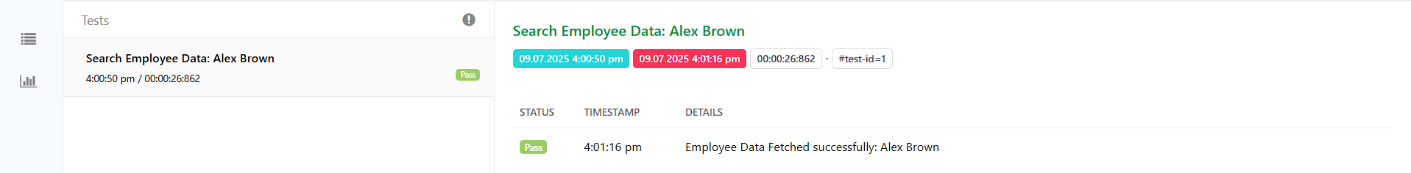
Test Report 3
Notes:
Test Case

Slide 26
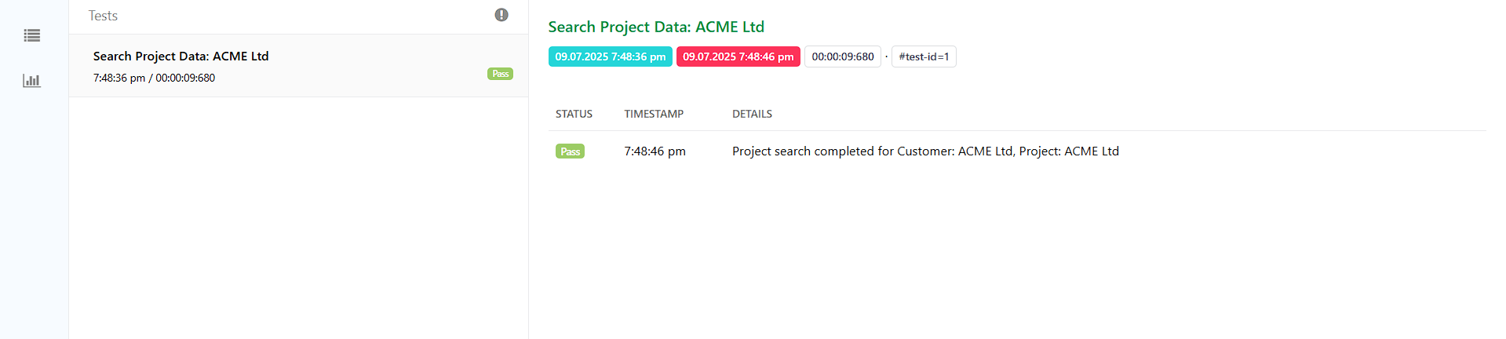
Test Report 4
Notes:
Test Case

Slide 27
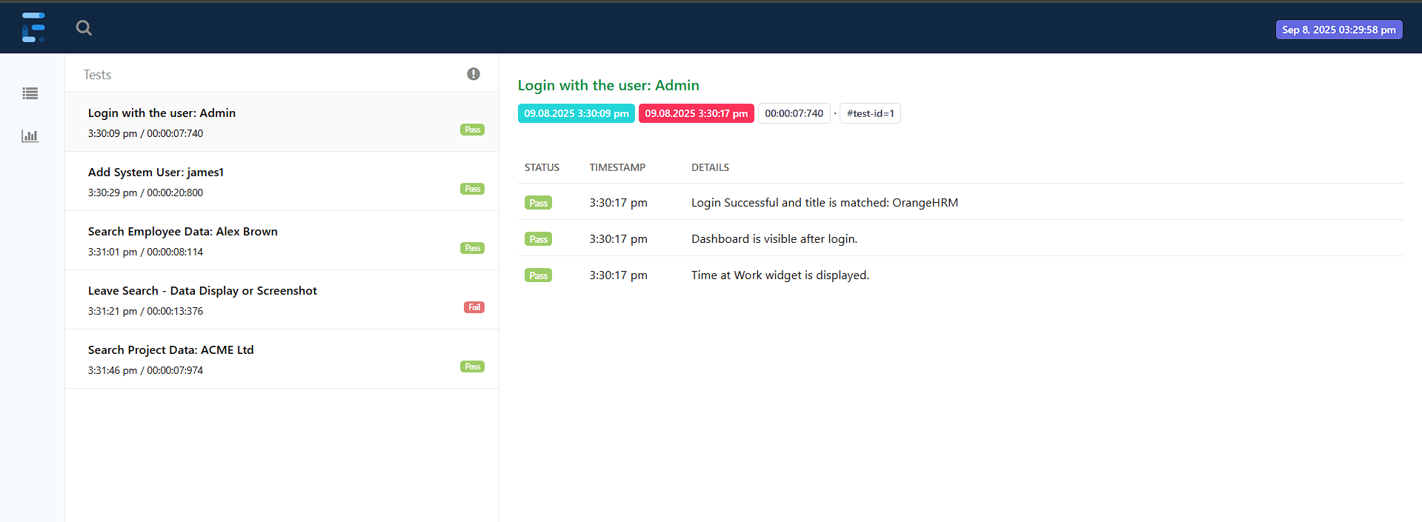
End-to-End Test Cases Extent Report

Slide 28
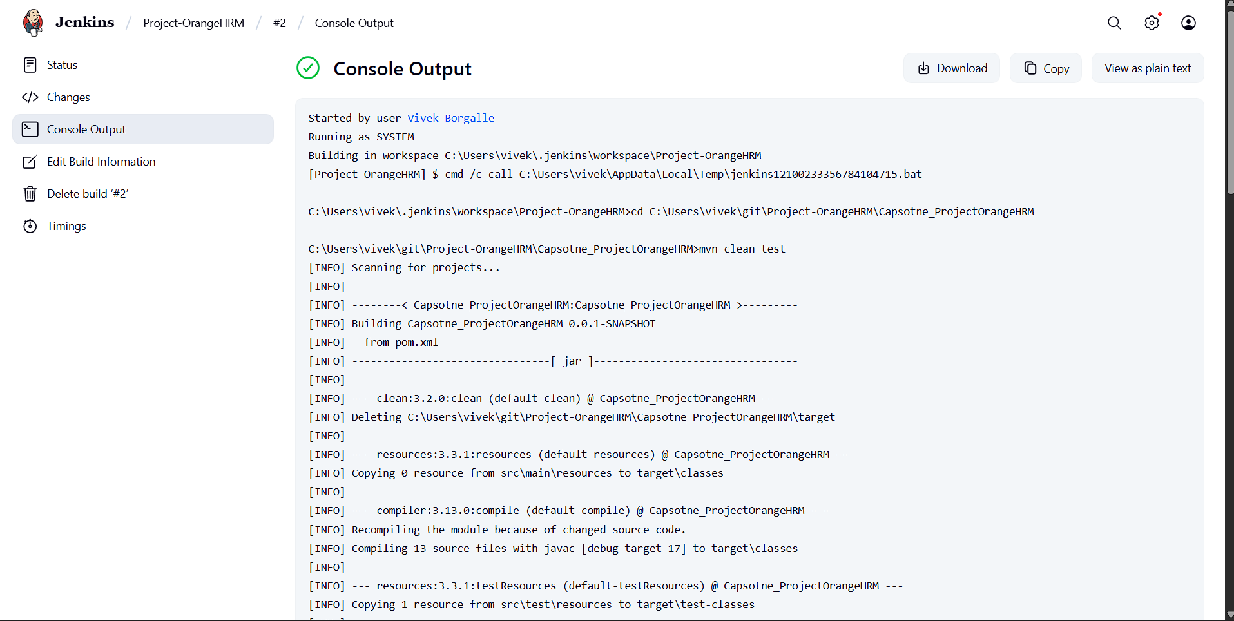
CI/CD Implementaion

Slide 30
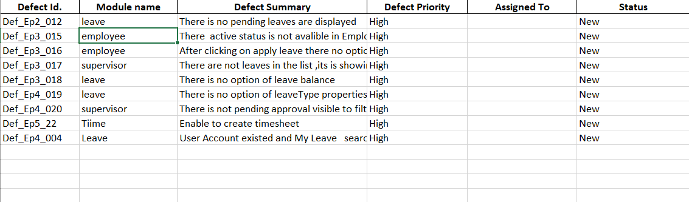
Defect Reports

Slide 31
CONCLUSION
Testing efforts became more time- and cost-efficient, boosting overall productivity. Test scripts were reusable and scalable, supporting future enhancements of OrangeHRM. Overall, automation testing ensured better quality, reliability, and stability of the application.
Testing efforts became more time- and cost-efficient, boosting overall productivity. Test scripts were reusable and scalable, supporting future enhancements of OrangeHRM. Overall, automation testing ensured better quality, reliability, and stability of the application.
Testing efforts became more time- and cost-efficient, boosting overall productivity. Test scripts were reusable and scalable, supporting future enhancements of OrangeHRM. Overall, automation testing ensured better quality, reliability, and stability of the application.
Testing efforts became more time- and cost-efficient, boosting overall productivity. Test scripts were reusable and scalable, supporting future enhancements of OrangeHRM. Overall, automation testing ensured better quality, reliability, and stability of the application.
Testing efforts became more time- and cost-efficient, boosting overall productivity. Test scripts were reusable and scalable, supporting future enhancements of OrangeHRM. Overall, automation testing ensured better quality, reliability, and stability of the application.
Testing efforts became more time- and cost-efficient, boosting overall productivity. Test scripts were reusable and scalable, supporting future enhancements of OrangeHRM. Overall, automation testing ensured better quality, reliability, and stability of the application.
Automation testing improved accuracy and consistency, reducing chances of human error in repetitive test cases.
Core functionalities like login, recruitment, leave, and time tracking were validated efficiently.
Automated scripts provided fast feedback during regression and integration cycles.
Testing efforts became more time- and cost-efficient, boosting overall productivity.
Test scripts were reusable and scalable, supporting future enhancements of OrangeHRM.
Overall, automation testing ensured better quality, reliability, and stability of the application.
.
Notes:
Testing efforts became more time- and cost-efficient, boosting overall productivity. Test scripts were reusable and scalable, supporting future enhancements of OrangeHRM. Overall, automation testing ensured better quality, reliability, and stability of the application.

